Slide 1
Comparison of Dictionary Implementations
1. Padala Preethi|15IT225
2.Navya W Prakash|15IT222
3. Manasa B|15IT219
4.Rashika Chowlek|15IT135

Slide 2
Introduction
A dictionary is a mapping between two sets of items, K, and V. It must support the following operations:
1. Insert an item v for a given key k. If key k already exists in the dictionary, its item is updated to be v.
2. Retrieve a value v for a given key k.
3. Remove a given k and its value from the Dictionary.

Slide 3
Dictionary as a part of computation is used in NLP. So Dictionary creation is laboured and Time consuming
In many information systems, a dictionary lookup is widely adopt and utilized as a part of computation. To use in memory dictionary, one of the most popular techniques is the using of trie structure to store a collection of words

Slide 4
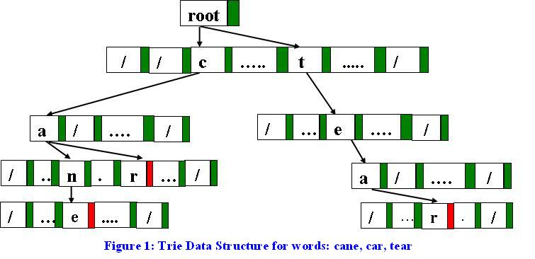
Trie

Slide 5
int trie_insert(struct trie_node *node, const char *word, char *description)
for (i = 0; i < strlen(word); i++)
int letter = letter_to_int(word[i]);
if (letter == -1)
// invalid character in the string, cannot be inserted into the trie
printf("failed to insert due to invalid character in word\n");
print_invalid_word(word, i);
printf(" description: \"%s\"\n", description);
return false;
if (!node)
node = malloc(sizeof(struct trie_node));
parent->children[letter] = node;

Slide 6
char *trie_get(struct trie_node *node, const char *word)
for (i = 0; i < strlen(word); i++)
int letter = letter_to_int(word[i]);
if (letter == -1)
return false;
if (!node)//element not found
return false;
return node->value;

Slide 7
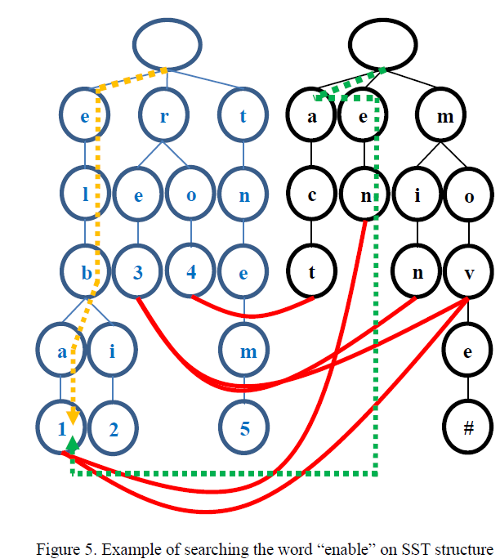
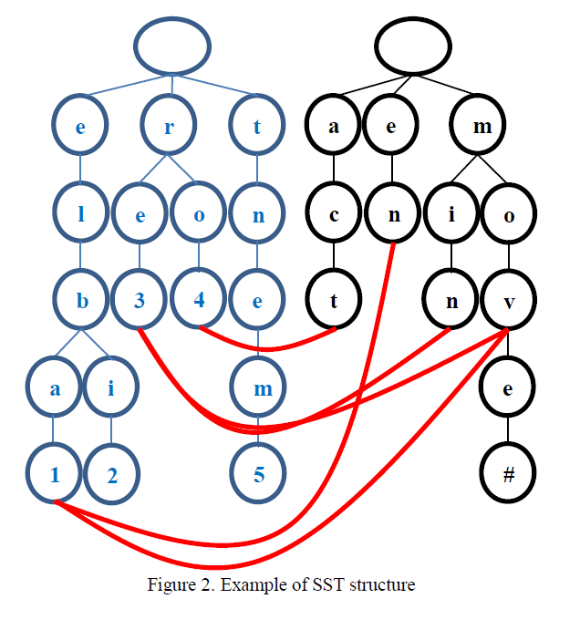
SST

Slide 8
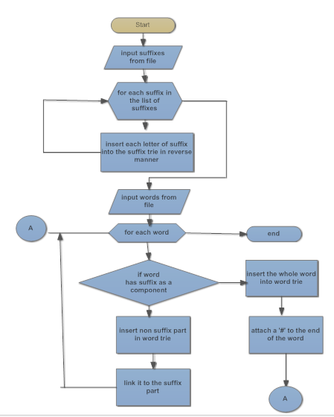

Slide 9
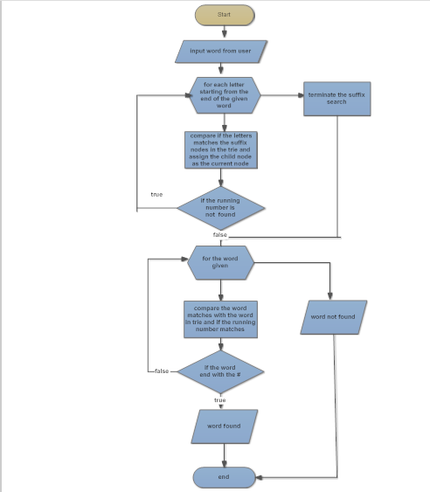

Slide 10
Ternary Search Tree
A ternary search tree is a special trie data structure where the child nodes of a standard trie are ordered as a binary search tree.
Representation of ternary search trees: Unlike trie(standard) data structure where each node contains 26 pointers for its children, each node in a ternary search tree contains only 3 pointers: 1. The left pointer points to the node whose value is less than the value in the current node.

Slide 11
2. The equal pointer points to the node whosevalue is equal to the value in the current node.
3. The right pointer points to the node whose value is greater than the value in the current node.

Slide 12
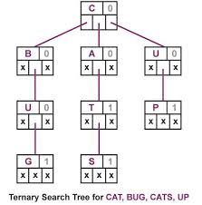

Slide 13
void insert(struct Node** root, char *word)
if (!(*root))
*root = newNode(*word);
if ((*word) < (*root)->data) // If current character of word is smaller than root's character,
insert(&( (*root)->left ), word); // then insert this word in left subtree of root
else if ((*word) > (*root)->data) // If current character of word is greate than root's character,
insert(&( (*root)->right ), word); // then insert this word in right subtree of root
else // If current character of word is same as root's character,
if (*(word+1))
insert(&( (*root)->eq ), word+1);
// the last character of the word
else
(*root)->isEndOfString = 1;

Slide 14
int searchTST(struct Node *root, char *word)
if (!root)
return 0;
if (*word < (root)->data)
return searchTST(root->left, word);
else if (*word > (root)->data)
return searchTST(root->right, word);
else
if (*(word+1) == '\0')
return root->isEndOfString;
return searchTST(root->eq, word+1);

Slide 15
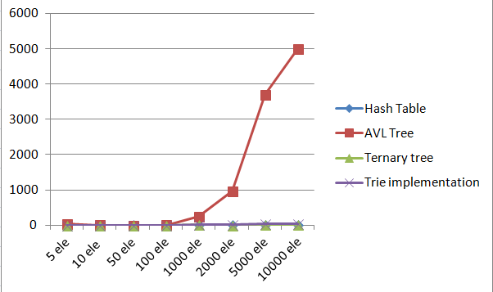
Comparsion

Slide 16
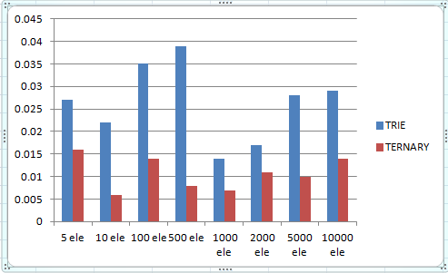
1.Best case

Slide 17
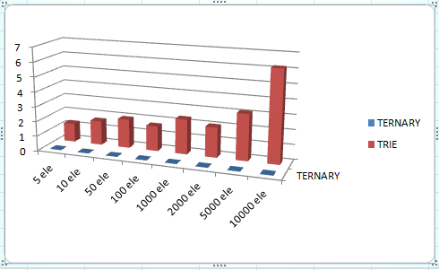
2.Average case

Slide 18
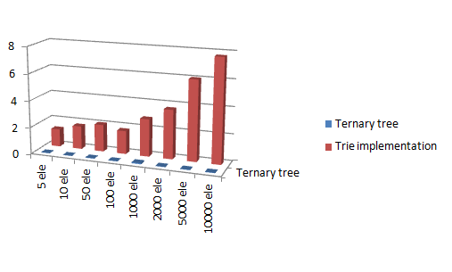
3.Worst Case

Slide 19
RESULTS
Hashing doesn’t support operations like prefix search. Prefix search is something where a user types a prefix and your dictionary shows all words starting with that prefix.
If we want both operations, look up and prefix search, Trieis suited. With Trie, we can support all operations like insert, search, delete in O(n) time where n is length of the word to be processed
concerning the space complexity , TST can be preferred. In Ternary Search Tree, time complexity of search operation is O(h) where h is height of the tree.

Slide 20
References
[1] Morimoto AK, Sato T. An Efficient implementation of trie structures. Software Pract Ex. 1992 Sep; 22(9):695–721.
[2] A. V. Aho, J. E. Hopcroft, and J. D. Ullman. Data Structures and Algorithms. AddisonWesley, Reading, Massachusetts, 1983.
[3]Kanimozhi Balaraman ,Implementation of Dictionaries using AVL Tree ,Indiana State Universit Terre Haute IN, USA December 11, 2011.
[4]Applied Data Structures with C++ ,By Peter Smith
[5]Donald Knuth. The Art of Computer Programming, volume 3. Addison-Wesley Publishing Co., Philippines, 1973

